Slide 1
CONNECTTEL
CUSTOMER CHURN PREDICTION PROJECT- Using Machine Learning to Reduce Customer Loss

Slide 2
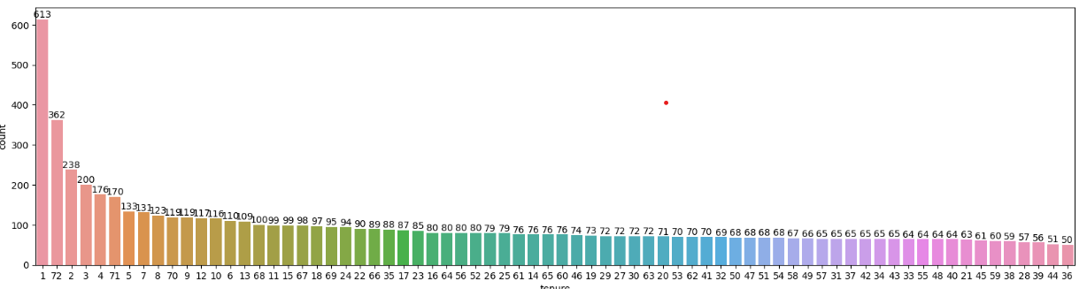
Problem Definition
The Challenge: Customer Churn at ConnectTel
ConnectTel is facing a significant customer churn problem.
Current retention strategies lack precision and effectiveness.
Losing customers to competitors threatens business sustainability and growth growth.
No 5163 Yes 1869 .
Only 26.58% of the total customers are churning
Approximately 30% of the customer leaving only have one day tenure
Notes:
Elaborate on the negative impact of customer churn on ConnectTel's revenue and market share.
Emphasize the need for a data-driven approach to identify customers at risk of churning.

Slide 3
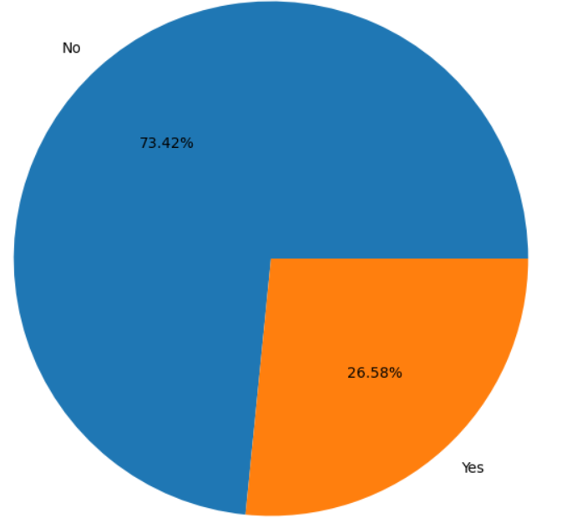
Project Goal
Our Solution: Predict Churn Using Machine learning
Develop a robust customer churn prediction system.
Leverage advanced analytics and machine learning techniques.
Proactively identify customers at risk of churning.
Notes:
Speaker Notes:
Explain how machine learning can analyze customer data and identify patterns that predict churn.
Briefly mention the type of data that will be used for the project.

Slide 4
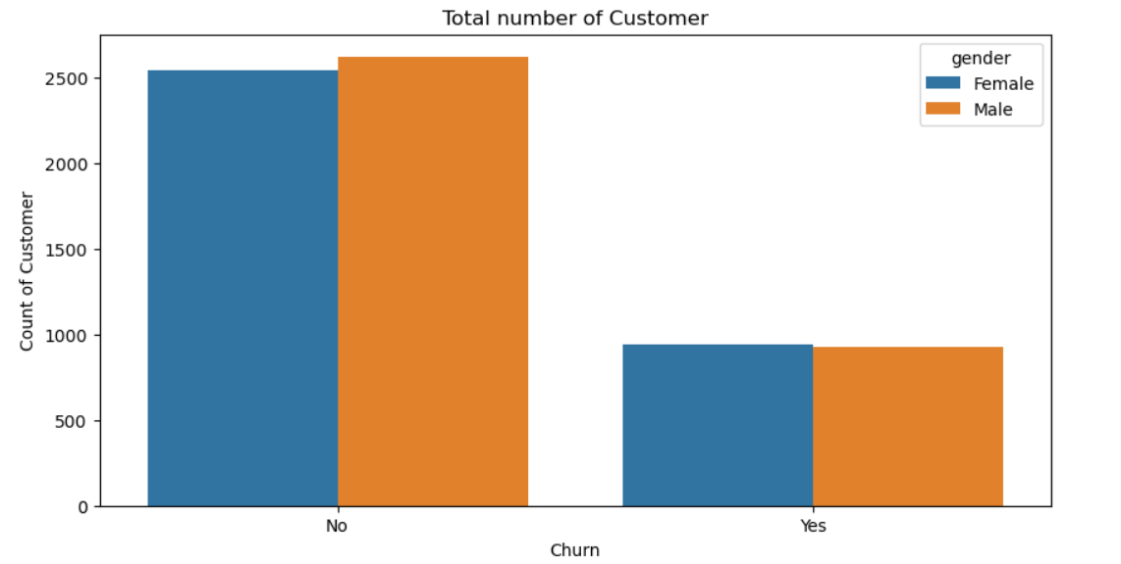
Data Exploration
Understanding the Data
Explore customer data using Python libraries (e.g., pandas).
Analyze relationships between features and churn.
Identify key factors influencing customer churn.
Notes:
Speaker Notes:
Briefly explain the process of exploratory data analysis (EDA).
Mention some of the key features in the dataset that might be relevant to churn prediction (e.g., tenure, service usage).

Slide 5
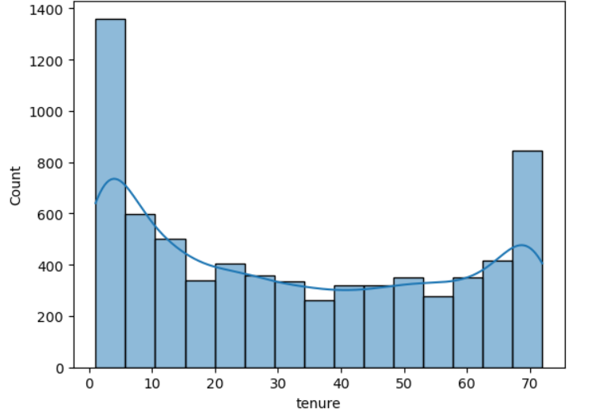
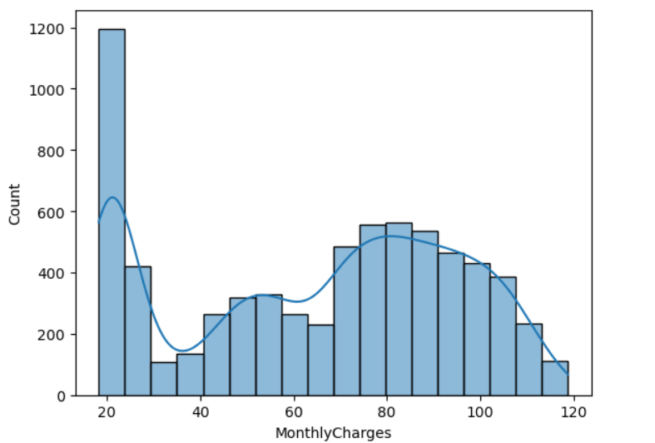
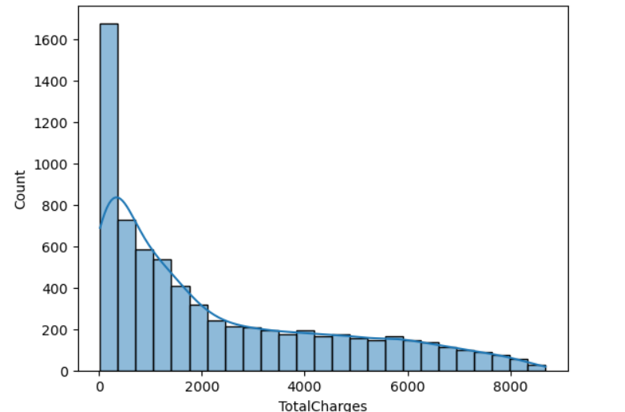
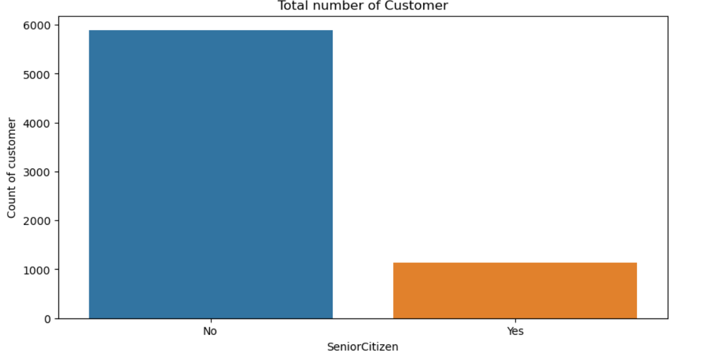

Slide 6
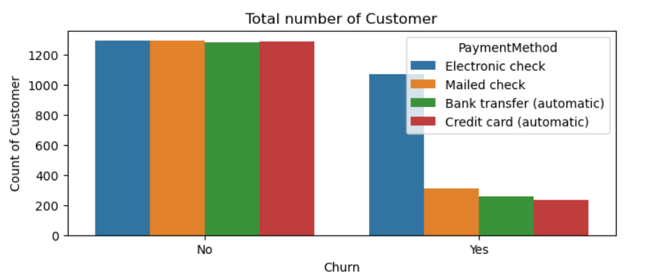
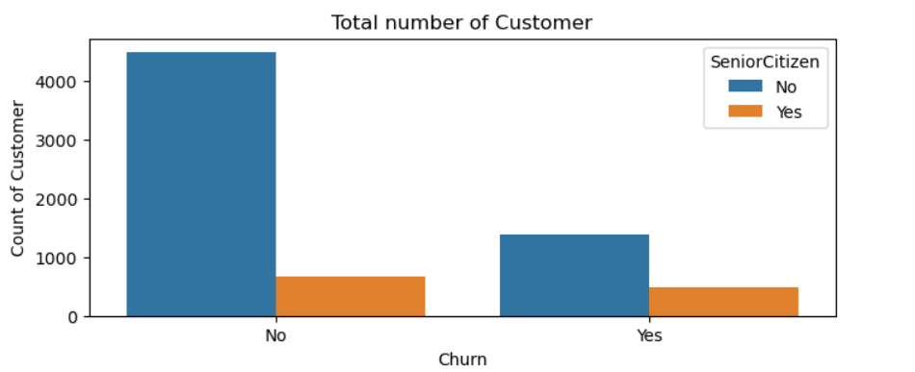
High number of customer that churned were using the electronic check payment method
Majority of the customers are not senior citizen. Only a few fraction of senior citizen are churning.

Slide 7
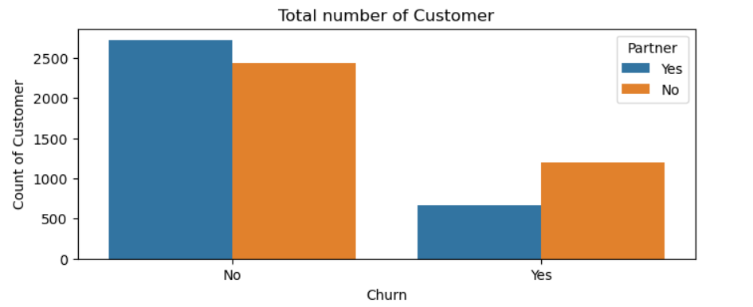
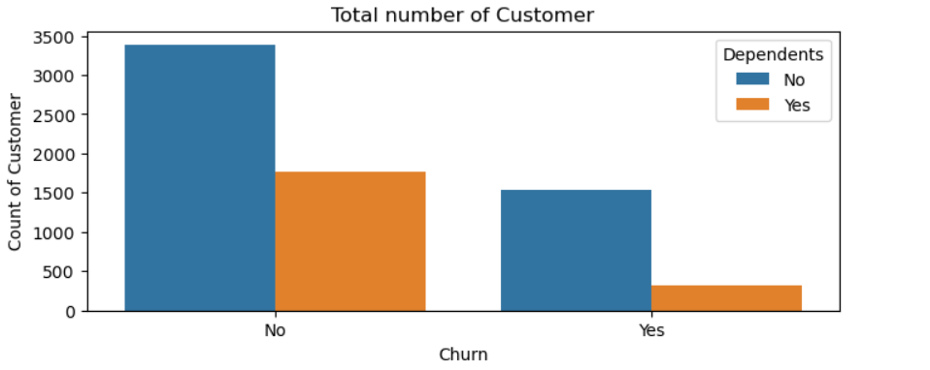
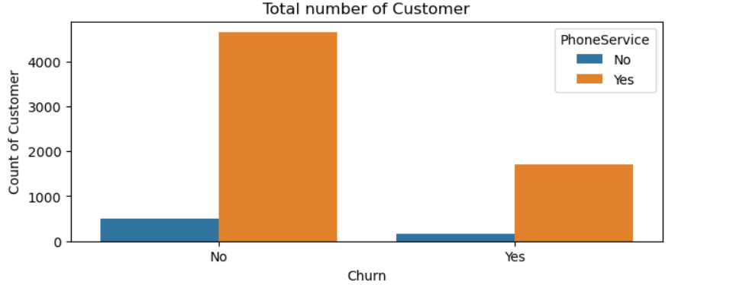
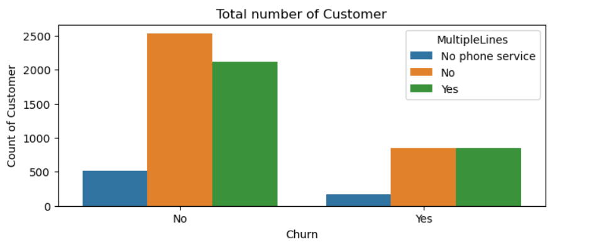
Out the customers churning, majority have no partner and dependent. CountTel phone service was an attraction.

Slide 8
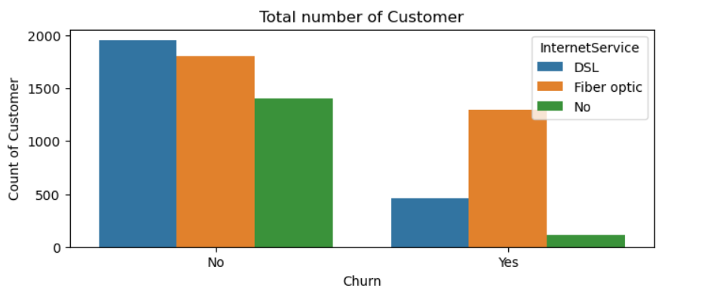
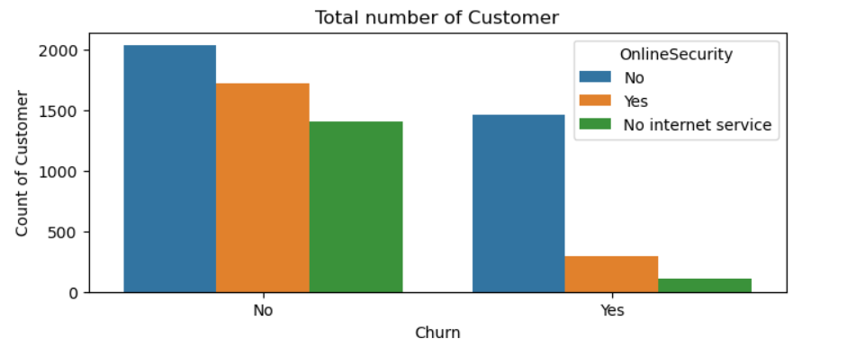
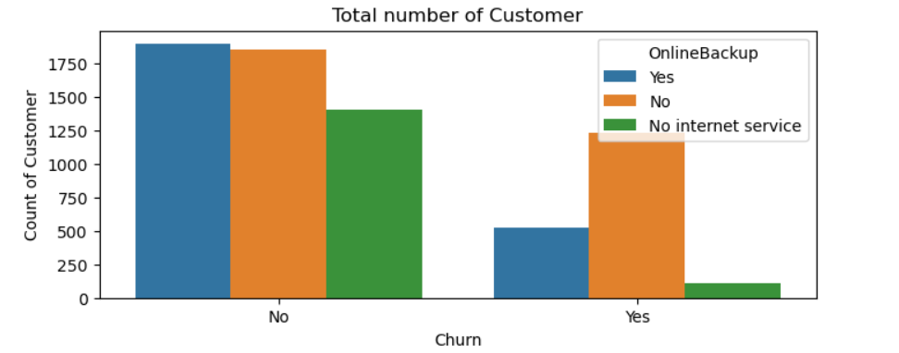
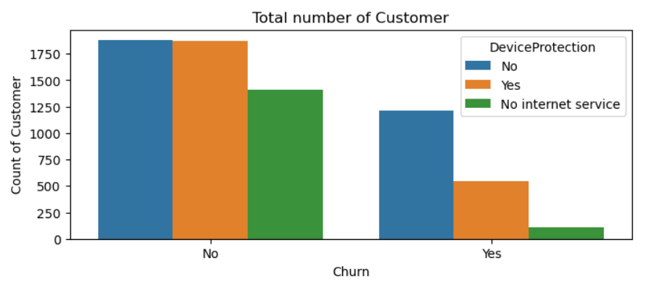

Slide 9
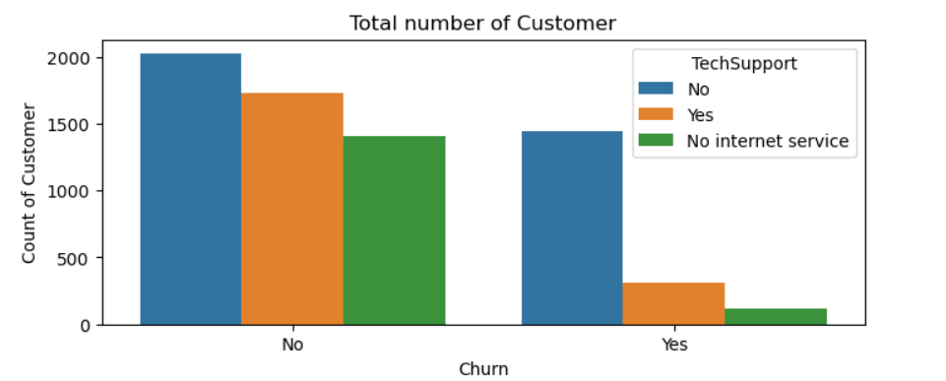
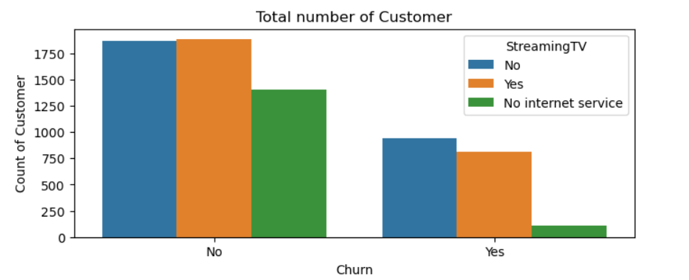
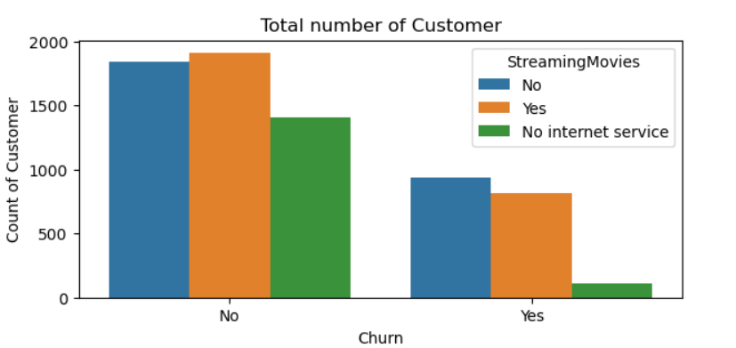
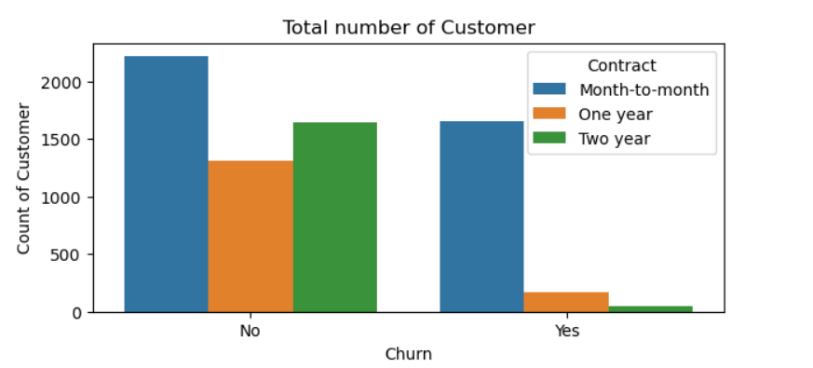

Slide 10
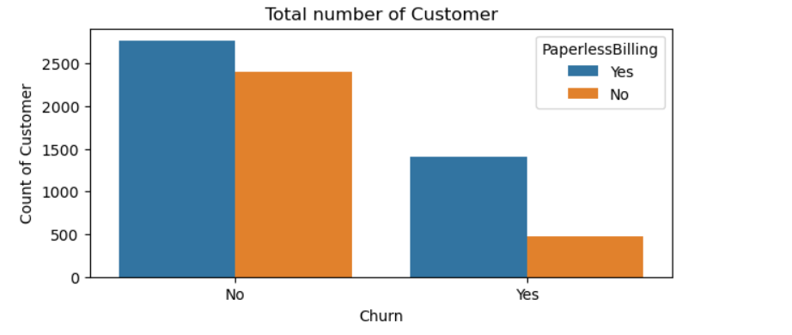
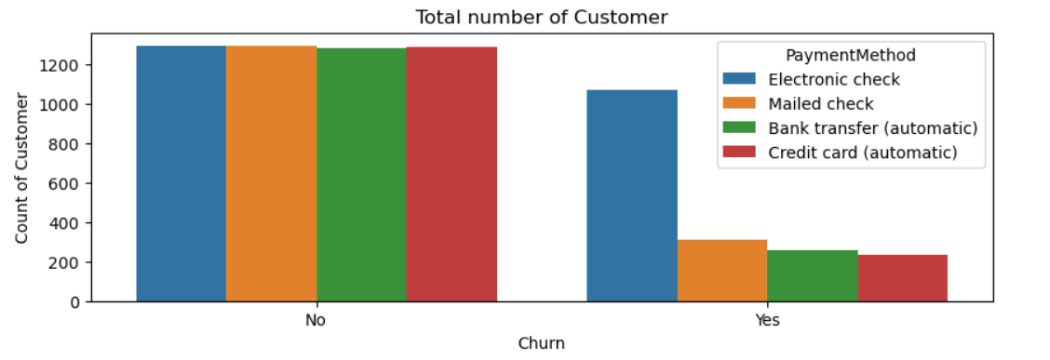
The Electronic Check payment method need to be checked.

Slide 11
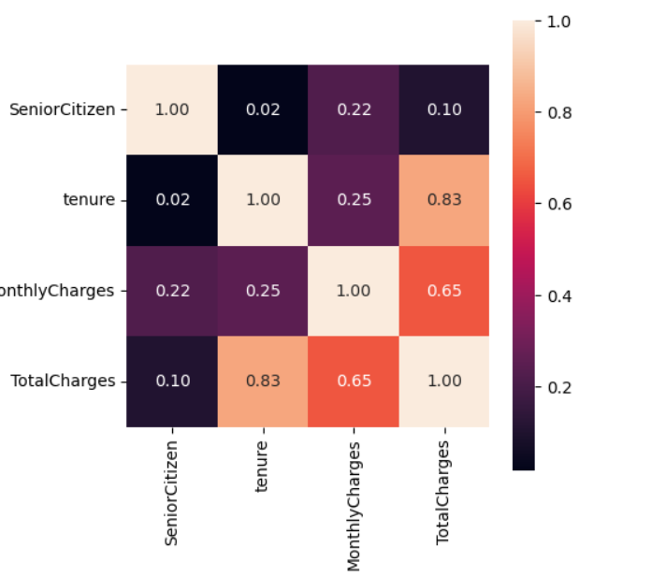
There is positive correction between Tenure , Monthly Charges and TotalCharges.

Slide 12
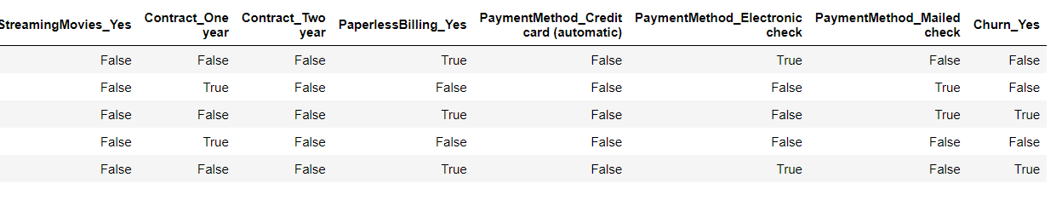
Feature Engineering
Preparing the Data for Machine Learning
categorical variables (e.g., gender).
Handle missing values and outliers. 11 details of customer were removed.
Notes:
Speaker Notes:
Explain the concept of feature engineering and its importance for machine learning models.
Provide specific examples of how you will prepare the data for modeling.

Slide 13
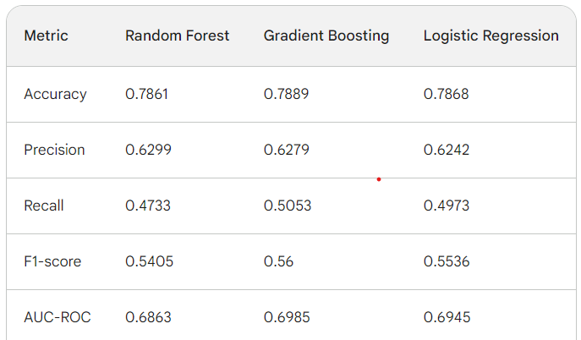
Model Selection and Training
Building the Churn Prediction Model
Train and test multiple supervised learning models.
Logistic Regression, Random Forest, Gradient Boosting.
Evaluate model performance using relevant metrics.
Notes:
Speaker Notes:
Briefly explain the concept of supervised learning models for classification tasks.
Mention the specific models you will be experimenting with and why they are suitable for churn prediction.

Slide 14
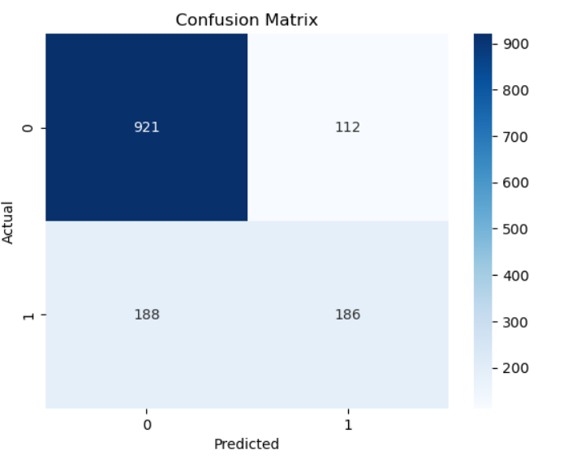
Model Evaluation
Evaluating Model Performance
Analyzed metrics like accuracy, precision, recall, F1-score, AUC-ROC.
Chose the model that best aligns with business goals.
Considered the trade-off between false positives and false negatives.
This is for the linear Regression where Actual churn were Yes but the model predicted 188 is No
Notes:
Speaker Notes:
Explain the importance of model evaluation metrics in choosing the best model.
Discuss the specific business goals of ConnectTel (e.g., minimizing false negatives) and how they influence model selection.

Slide 15
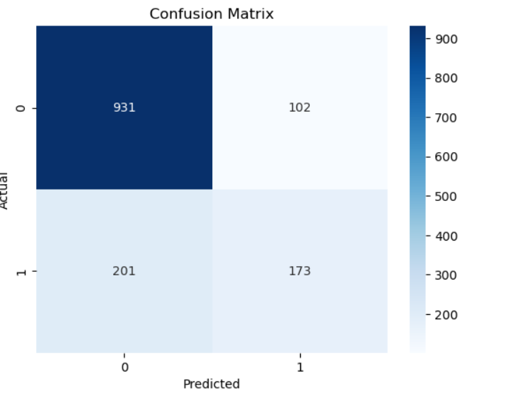
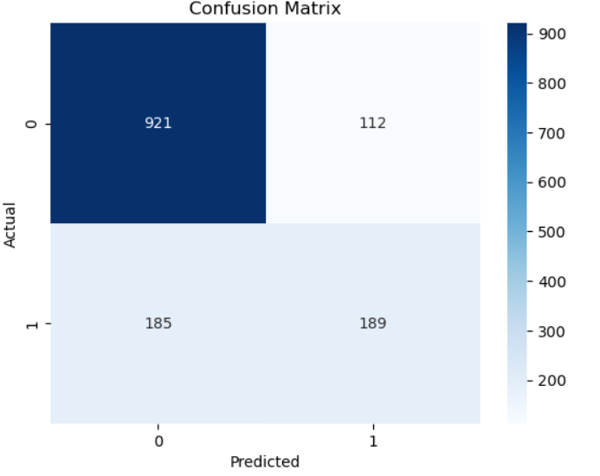
This is for the Random Forest Classifier where Actual churn were Yes but the model predicted 201 is No.
This is for the Gradient Boosting model where Actual churn were Yes but the model predicted 185 is No.

Slide 16
Observations
•All three models achieved very similar accuracy scores, suggesting they can correctly classify a comparable portion of the data.
•Precision and Recall values are also quite similar across the models. All three models seem to be over-predicting positive cases (generating false positives) to some extent.
•F1-score and AUC-ROC values are also close, indicating a similar balance between precision and recall and a slightly better than random chance ability to distinguish positive and negative cases.
Key Differences
•Gradient Boosting shows a slight edge in Recall compared to both Random Forest and Logistic Regression, meaning it might be better at identifying actual positive cases.
•Logistic Regression might be slightly simpler to interpret compared to Random Forest and Gradient Boosting, which can be more complex models.

Slide 17
Conclusion and Next Steps
The Path Forward: Using Churn Prediction for Retention
Choosing the Best Model
If minimizing false positives, It is crucial that the company prioritize Logistic Regression or explore models with higher precision.
If identifying all positive cases (e.g., capturing all churning customers) is more important, Gradient Boosting might be a better choice due to its higher recall. Optimizing the Gradient Boost model can give us also a better performance.
Next Steps
Productionize and integrate the chosen model into ConnectTel's system for real-time churn prediction.
Develop targeted retention strategies based on churn risk scores generated by the model.
More data will be required to perform more exploratory data Analysis.
ConnectTel phone service need to looked into .
We also need to see the Tenure and churn rate over time.
Recommend also to send out questionnaire to customers that left. This will be a good way also to get direct feedback from Customer.

